Slide 1
Main Idea and the
Supporting Details

Slide 2
The Topic Sentence & Supporting detail
Many paragraphs have topic sentences that indicate what their about.
Find the topic sentence in this paragraph:
Homeless people have many problems. In winter, it’s hard to stay warm and it gets too hot in summer. It’s also hard to keep things safe without a home. Worst is the lack of privacy.
Supporting details prove the value of the main idea. What are they here?

Slide 3
Supporting Details = Additional information to help understand the main idea
Details consists of specific information such as:
Examples, Illustrations
Facts and Statistics
Reasons
Incident
Descriptive Details
Steps or Procedures
Comparison or Contrast.
also,
Who, what, when, where, why, how?
The answers will be in the details.

Slide 4
Main Idea
The main idea answers the question,
“What is the author’s one most important point about the topic?”
Must always contain the topic (the word, name, or phrase that tells who or what the paragraph is about)
Must always make complete sense by itself (even if you couldn’t read the rest of the paragraph)
Must be a general sentence that sums up the details in the paragraph

Slide 5
Location of the Stated Main Idea Sentence
Can appear anywhere in a paragraph:
Most often it appears at the beginning.
The next most likely location is at the end.
The third possibility is somewhere else within the paragraph.
Regardless of where it appears, it will have supporting details that explain more about it, give examples of it, or prove it.

Slide 6
Read the entire paragraph before you decide
Is it asking about:
  The overall main idea?
  The subject?
  The theme?
choose the answer that deals with the whole selection, not just part of the selection.
Longer selections (textbook sections, essays, articles, and editorials) can have overall stated main ideas.
The main idea is general. Details are specific.
Examples are always details.
Details are often introduced by In addition, also, moreover, another, next, then, last, finally, etc.

Slide 7
Remember:
Only ONE sentence can be the stated main idea in a paragraph.
The main idea is NEVER a question.
  Examples are details that support the main idea, so examples cannot be the main idea.
  Watch for words or phrases authors use to signal their main idea: The point is, It is important, Thus, etc.

Slide 8
Lantern fish live near the bottom of the ocean where it is very dark, so they carry their own lights. The lights look like tiny glowing pearls. They are called photo-phores. A lantern fish can flash its photo-phores on and off.
The light looks like tiny glowing pearls.
Lantern fish live near the bottom of the ocean where it is very dark, so they carry their own lights.
Lantern fish live near the bottom of the ocean where it is very dark, so they carry their own lights. 1-The lights look like tiny glowing pearls. 2-They are called photo-phores. 3-A lantern fish can flash its photo-phores on and off.

Slide 9
Next time you see lightning, count the number of seconds that pass until you hear thunder. The lightning is a mile away for every five seconds that you count. In this way, you can “measure” how far the lightning is from you. Scientists know that the speed of light is faster than the speed of sound. So calculating the difference between the two speeds, they have developed this easy five-second formula.
You can figure out how far away lightning is.
The lightning is a mile away for every five seconds that you count.

Slide 10

Finding an Inferred Main Idea:
Imply - means to suggest an idea but not state it directly.
  Ex: “If that blue shirt is back in my closet by noon, I’ll forget that it was missing.”
Infer - means to reason out something based on what has been said.
  Ex: I wouldn’t even feed that cake to my dog.
Find the topic of the selection.
Decide what the author wants you to know about the topic.
Express the idea in your own words.
An implied main idea is not stated directly but is strongly suggested by the supporting details.

Slide 11
Using Supporting Details and Thought Patterns to Find Implied Main Ideas
The implied main idea
  must be general enough to cover all the details,
  must not be so broad that it is an overgeneralization
  must not be a sweeping statement that suggests details not given
To find the implied main idea, create a summary from the supporting details.

Slide 12
Questions for Finding the Implied Main Idea
What is the topic, or subject, of the paragraph?
What are the major supporting details?
Based on the details about the topic, what point or main idea is the author trying to get across?
What larger idea do these details point to?
The wind was blowing at 35 mph.
The wind chill was 5 degrees below zero.
Snow was falling at the rate of 3 inches per hour.

Slide 13

Figuring Out Implied Main Ideas
Wind 35 mph
- 5 degree wind chill
Snow 3” per hour
Blizzard

Slide 14
Figuring Out Implied Main Ideas
The child refused
to speak.
What is the implied
general idea?
The child crossed his arms
and turned his back.
The child then threw
himself to the floor.

Slide 15
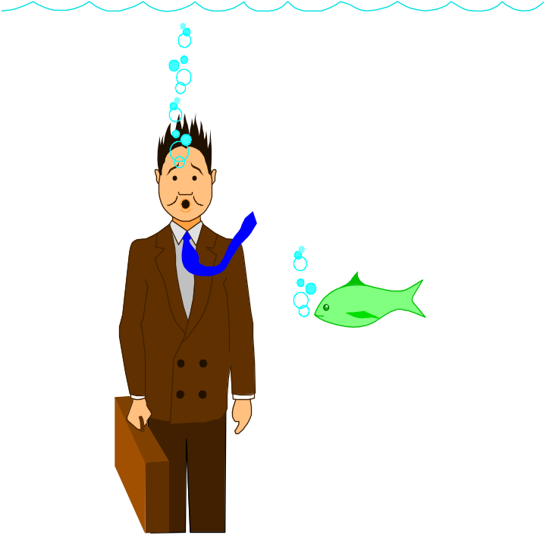
What is the implied main idea?
Fear drains color from our faces, makes our teeth chatter, our hearts pound, our breath quicken, and our knees knock. Fear churns our stomachs, raises goose bumps, and causes jitters. Fear also raises feelings of anxiety and distrust, and may even cause us to change our behaviors. Obsessive fear can become a phobia that keeps us from enjoying life.
Phobias keep us from enjoying life.
Fear affects us in several ways.
Fear is the result of distrust and anxiety.
Fear affects many people.

Slide 16

What is the implied main idea?
Green tea has been used for thousands of years in Asia as both a beverage and an herbal medicine. This herbal tea contains catechin, which is a type of tannin that acts as an astringent. Research suggests that men and women in Japan who drink five to six cups of green tea each day have much lower rates of cancer than people who do not. Green tea is also thought to lower cholesterol and blood sugar, control high blood pressure, stop tooth decay, and fight viruses. Green tea has even been credited with the power to slow down the aging process.
Green tea is an ancient herbal drink.
Green tea has caught the attention of medical researchers.
Green tea has many positive properties as a health drink.

Slide 17
1.Fire ants are painful and destructive pests. 2.The fire ant earned its name because of its venom. 3.The insect uses a wasp-like stinger to inject the venom, which causes a painful burning sensation and leaves tiny, itching pustules. 4.The ants will swarm over anyone or anything that disturbs their nests. 5.In addition to causing pain, fire ants damage many crops by eating the plants and by protecting other insects that damage crops. 6.Fire ants are attracted to soybeans, eggplant, corn, okra, strawberries, and potatoes.

Slide 18
1. What is the topic of the passage?
a. Ant bites
b. Fire ants
c. Farming
d. Pests
2. What does the author want you to know about the topic?
a. Fire ants have a wasp-like stinger.
b. Fire ants swarm.
c. Fire ants are pests to farmers.
d. Fire ants are painful and pesky.
3. Which sentence contains the main idea?
a. 1 b. 2 c. 4 d. 5

Slide 19
Implied Main Ideas
identifying the topic and main idea:
• Remember to look for repeated words
• Mark major supporting details. Major details are often signaled by addition words
Addition Words
one to begin with also further
first (of all) for one thing in addition furthermore
second(ly) other next last (of all)
third(ly) another moreover final(ly)
Notes:
See page 104 in textbook.

Slide 20
Implied Main Ideas
Read the paragraph below. Then answer the question.
All people have a strong need to belong to groups, stemming from evolutionary pressures that increased people’s chance of survival and reproduction when in groups rather than in isolation. This need may also be driven by the desire to feel protected against threat and uncertainty in everyday life or to gain a greater sense of personal and social identity. Moreover, people join specific groups in order to accomplish things that they cannot accomplish as individuals. Neither symphonies nor football games can be played by one person alone, and many types of work require team effort. Further, people join groups because of the social status and identity that they offer. An important part of people’s feelings of self-worth comes from their identification with particular groups. Even a relatively low-status group can be a source of pride for individuals who are held in high esteem within the group; being big fish in small ponds can make people feel good about themselves, particularly people from individualist cultures. Finally, people may join groups simply because they like the members and want to have the opportunity to interact with them.
What is the topic of the paragraph?
Notes:
See pages 104 and 105 in textbook.
ANSWER: Joining groups
The next slide shows the answer.

Slide 21
Implied Main Ideas
All people have a strong need to belong to groups, stemming from evolutionary pressures that increased people’s chance of survival and reproduction when in groups rather than in isolation. This need may also be driven by the desire to feel protected against threat and uncertainty in everyday life or to gain a greater sense of personal and social identity. Moreover, people join specific groups in order to accomplish things that they cannot accomplish as individuals. Neither symphonies nor football games can be played by one person alone, and many types of work require team effort. Further, people join groups because of the social status and identity that they offer. An important part of people’s feelings of self-worth comes from their identification with particular groups. Even a relatively low-status group can be a source of pride for individuals who are held in high esteem within the group; being big fish in small ponds can make people feel good about themselves, particularly people from individualist cultures. Finally, people may join groups simply because they like the members and want to have the opportunity to interact with them.
What is the topic of the paragraph?
Joining groups
Notes:
See pages 104 and 105 in textbook.

Slide 22
Implied Main Ideas
All people have a strong need to belong to groups, stemming from evolutionary pressures that increased people’s chance of survival and reproduction when in groups rather than in isolation. This need may also be driven by the desire to feel protected against threat and uncertainty in everyday life or to gain a greater sense of personal and social identity. Moreover, people join specific groups in order to accomplish things that they cannot accomplish as individuals. Neither symphonies nor football games can be played by one person alone, and many types of work require team effort. Further, people join groups because of the social status and identity that they offer. An important part of people’s feelings of self-worth comes from their identification with particular groups. Even a relatively low-status group can be a source of pride for individuals who are held in high esteem within the group; being big fish in small ponds can make people feel good about themselves, particularly people from individualist cultures. Finally, people may join groups simply because they like the members and want to have the opportunity to interact with them.
What is the implied main idea of the paragraph?
Notes:
See pages 104 and 105 in textbook.
ANSWER: People join groups for a number of reasons.
The next slide explains the answer.

Slide 23
Implied Main Ideas
All people have a strong need to belong to groups, stemming from evolutionary pressures that increased people’s chance of survival and reproduction when in groups rather than in isolation. This need may also be driven by the desire to feel protected against threat and uncertainty in everyday life or to gain a greater sense of personal and social identity. Moreover, people join specific groups in order to accomplish things that they cannot accomplish as individuals. Neither symphonies nor football games can be played by one person alone, and many types of work require team effort. Further, people join groups because of the social status and identity that they offer. An important part of people’s feelings of self-worth comes from their identification with particular groups. Even a relatively low-status group can be a source of pride for individuals who are held in high esteem within the group; being big fish in small ponds can make people feel good about themselves, particularly people from individualist cultures. Finally, people may join groups simply because they like the members and want to have the opportunity to interact with them.
What is the implied main idea of the paragraph?
People join groups for a number of reasons.
Explanation
Each major detail in the paragraph is one reason that people join groups. Note that four of the major details are signaled by addition words.
Notes:
See pages 104 and 105 in textbook.

Slide 24
We’re often told “He who hesitates is lost,” but we’re also warned to “look before you leap.” Most of us have heard the saying, “Out of sight, out of mind,” but then we hear “Absence makes the heart grow fonder.” Everyone talks about “love at first sight.” But then someone reminds us, “Marry in haste, repent at leisure.” It’s all very confusing.
There are many sayings in our culture that contradict one another or are very confusing.

Slide 25
IMPLIED MAIN IDEAS in Longer Passages
To find the implied central idea in a longer passage, you must ask the same three questions you used to find the main ideas in paragraphs:
• Who or what is this passage about?
(What is the topic?)
• What is the central point the author is trying to make about that topic?
When you think you know the central idea, you can test it by asking:
• Does all or most of the material in the passage support this idea?
Notes:
See pages 107 and 108 in textbook.

